Slide 1
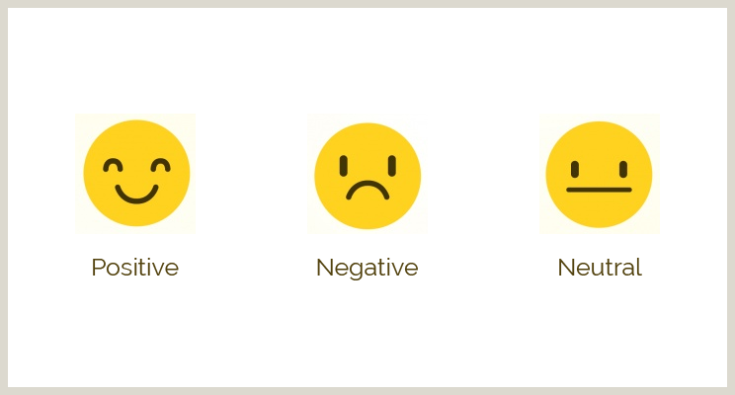
TCS ION Project Schedule:- “Automate Sentiment Analysis of Textual Comments and Feedback.” -Viraj Vasudeo Thakare

Slide 2
Day 1 to Day 3 (“Project Initiation”)
7/09/2023 to 10/09/2023
Define project objectives and scope.
Identify key stakeholders.
Create a project plan and timeline.

Slide 3
Day 4 to Day 6 (“Requirements Gathering”)
11/09/2023 to 13/09/2023
Collect and document the requirements for sentiment analysis.
Identify data sources for comments and feedback.
Collect(Download) Datasets from “Kaggle”.
Install important Libraries in PyCharm.

Slide 4
Day 7 to Day 9 (“Data Collection and Preprocessing”)
14/09/2023 to 16/09/2023
Gather the necessary textual comments and feedback.
Preprocess the data, including cleaning and formatting.

Slide 5
Day 9 to Day 15 (“Sentiment Analysis Deployment and Monitoring”)
17/09/2023 to 22/09/2023
Train and test the model using the collected data.
Develop or select a sentiment analysis model.
Implement and test the sentiment analysis algorithm.
Optimize the model for performance.

Slide 6
Day 16 to Day 19 (“Model Integration”)
23/09/2023 to 26/09/2023
Integrate the sentiment analysis model into the codebase.
Ensure compatibility with the data preprocessing scripts.
Test the integrated model.

Slide 7
Day 19 to Day 22 (“Testing and Quality Assurance”)
27/09/2023 to 30/09/2023
Conduct extensive testing to identify and fix any issues in the code.
Verify the accuracy and reliability of sentiment analysis results.

Slide 8
Day 22 to Day 25 (“Deployment and Monitoring”)
1/10/2023 to 4/10/2023
Deploy the code in a production environment.
Implement monitoring and logging for system performance.

Slide 9
Day 26 to Day 31 (“Feedback Collection and Refinement)”)
5/10/2023 to 10/10/2023
Collect feedback from users or other stakeholders.
Make necessary refinements based on feedback
Final Testing and Quality Assurance
Conduct a final round of testing and quality assurance.
Address any issues or bugs.

Slide 10
Day 32 to Day 40 (“Optimization & Code Review”)
11/10/2023 to 19/10/2023
Identify areas for code optimization.
Implement performance improvements.
Review the code with key stakeholders.
Obtain final approval for the project.

Slide 11
Day 41 (“Final Testing & Project PPT ”)
20/10/2023
Final Testing and Verification: Conduct a final round of testing to ensure that all components of your code are functioning correctly. This includes testing for any recent updates or changes.
Schedule Presentation: Create a PowerPoint presentation summarizing the project schedule and timeline, highlighting milestones and achievements.

